Slide 1
Jermyn Borough Council Meeting
3/16/2023

Slide 2

Meeting Agenda
MARCH 16, 2023
CALL TO ORDER
PLEDGE OF ALLEGIANCE
ROLL CALL
PREVIOUS MEETING MINUTES
TREASURER REPORT/BILLS PAYABLE
SECRETARY REPORT
CORRESPONDENCE
PUBLIC COMMENT
PROFESSIONAL REPORTS
POLICE
FIRE
SOLICITOR
CODE ENFORCEMENT
ZONING
ENGINEER
TAX COLLECTOR
MAYOR
COMMITTEE REPORTS
SAFETY
PLANNING
FINANCE
SHADE TREE
REC
MS4
DPW
NEW BUSINESS

Slide 3
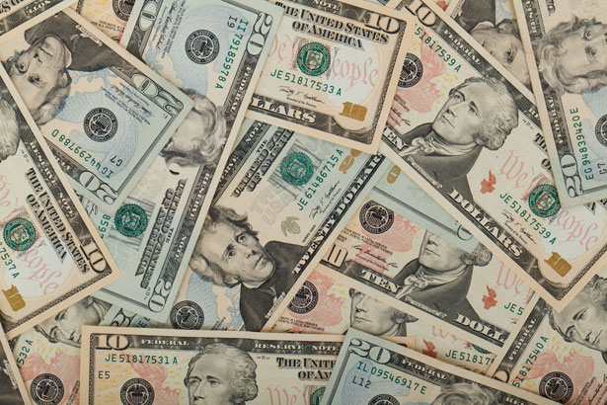
Treasurer’s report
3/16/2023
ASSETS
Checking/Savings
American Rescue Plan Fund 151,668.12
Capital Reserve - DPW 10,728.08
Capital Reserve - Police 5,006.82
Crime Watch Fund 222.69
General Fund - Community 55,196.60
General Fund - FNB 6,027.55
Holiday Lights Fund 1,459.09

Slide 4
Treasurer’s report
Investment - General Fund 1,020.97
Investment - Liquid Fuels 22,470.90
Investment - Paving Fund 1,031.58
Investment - Recycling 100.61
Investment - Refuse 150.74
Liquid Fuels - FNB 4,899.73
Petty Cash 225.00
Recreations Fund 26,807.89
Recycling - Community 17,656.76
Refuse Checking - FNB 1,568.33
Total Checking/Savings 306,241.46

Slide 5
Treasurer’s report
200000 · Accounts Payable 10,191.01
Long Term Debt 240,599.08

Slide 6
MS4 Minute
https://www.youtube.com/watch?v=ETxPvaiwp5g&t=39s

Slide 7


